Slide 1
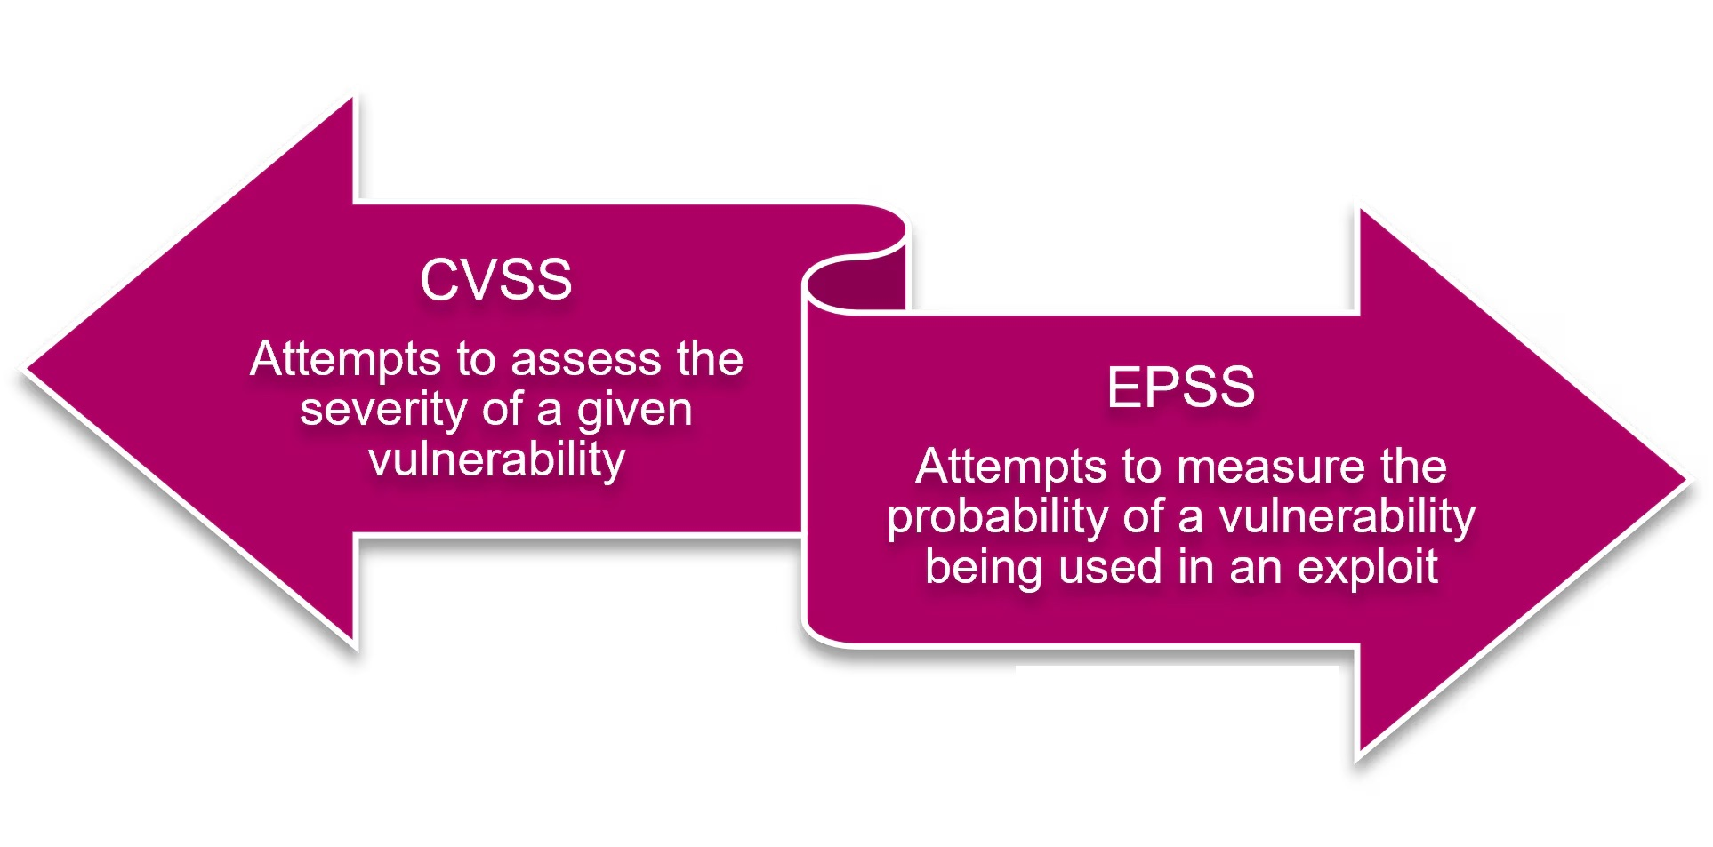
Presented by
Professor Dr. Mohammed Shafiul Alam Khan
IIT, DU

Slide 2
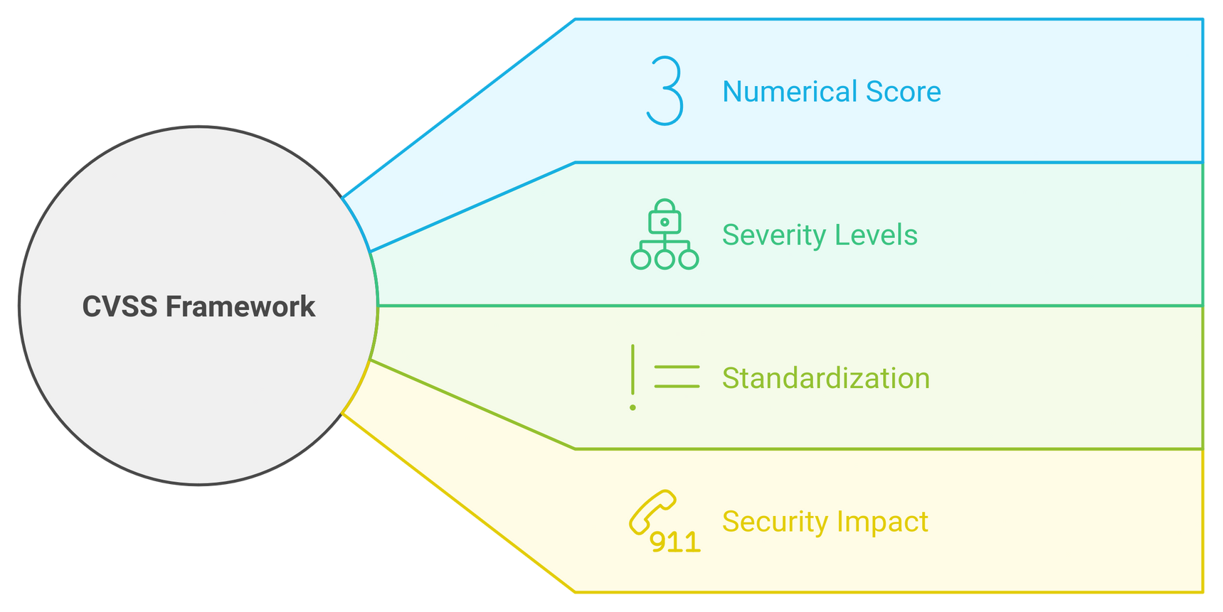
CVSS (Common Vulnerability Scoring System)
A standardized framework that measures the severity of security vulnerabilities
Provides a standardized method for rating vulnerabilities based on their impact.
Assigns a numerical score between 0 and 10 to each vulnerability, with higher scores indicating more severe issues

Slide 3
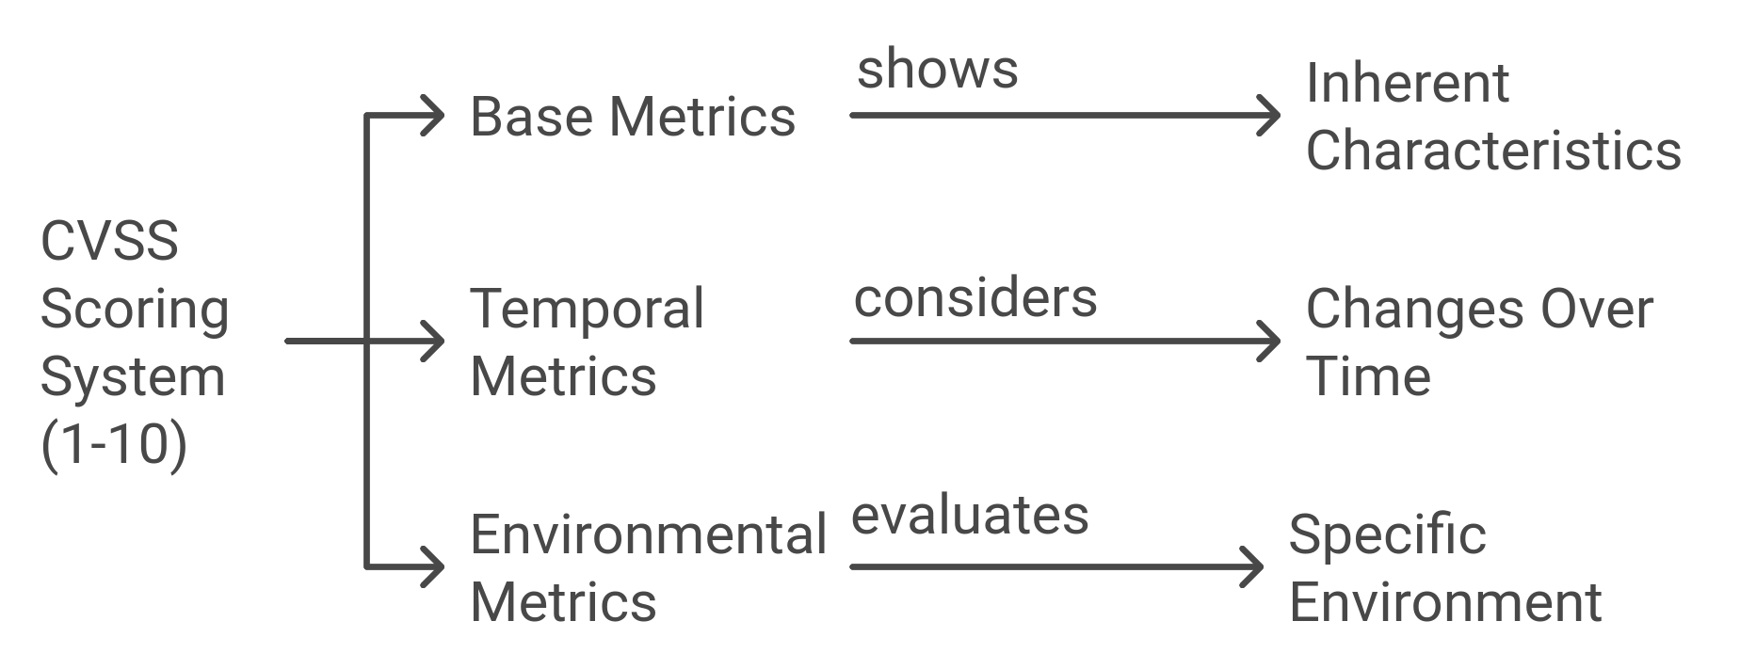
How Does It Work?

Slide 4
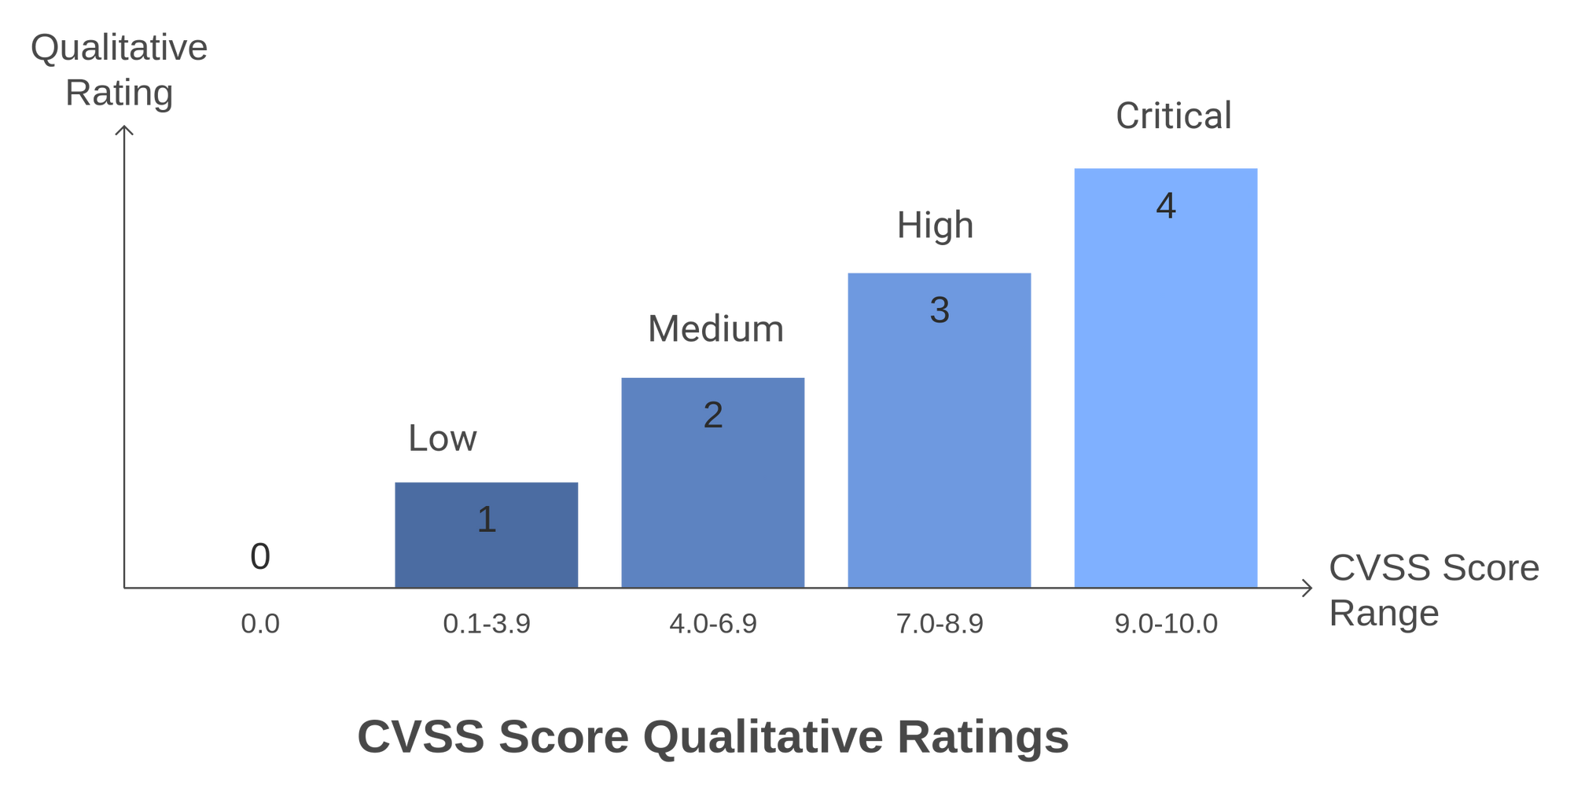
CVSS Score

Slide 5
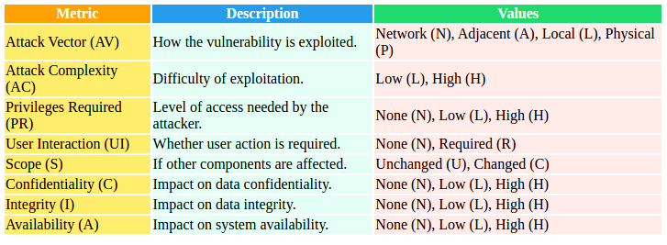
Base Metrics
DESCRIBES CORE unchanging CHARACTERISTICS OF THE VULNERABILITY.
INCLUDES _____
CVSS PRIMARY METRIC GROUPS

Slide 6
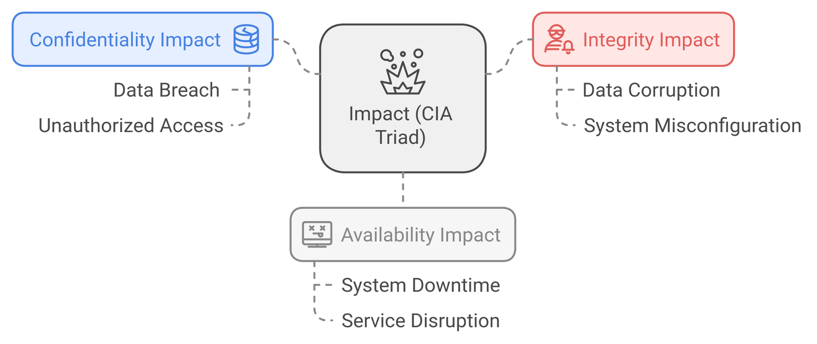
Base Metrics
IMPACT _________
CVSS PRIMARY METRIC GROUPS

Slide 7
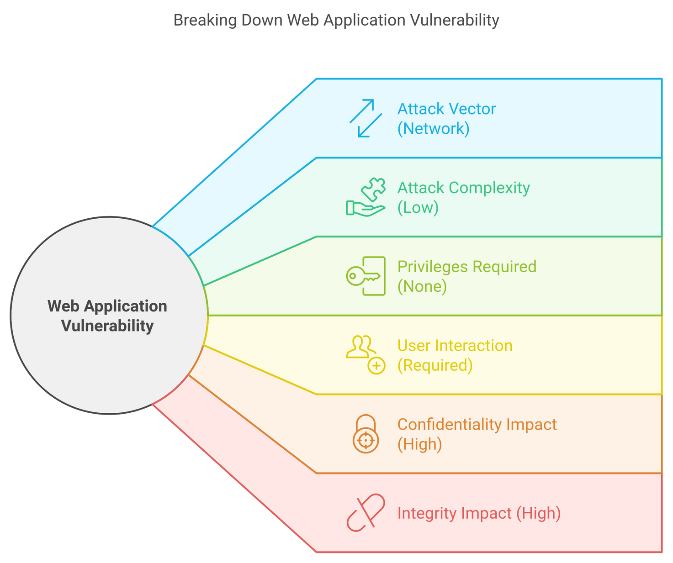
Base Metrics
Example
CVSS PRIMARY METRIC GROUPS

Slide 8
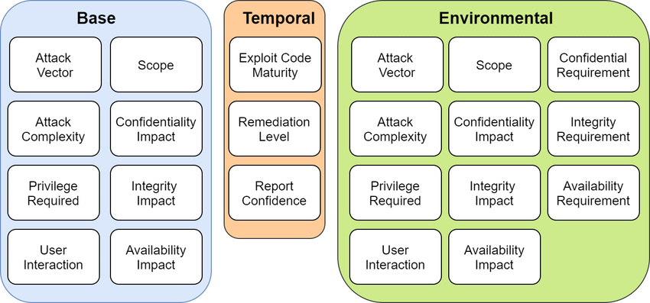
CVSS PRIMARY METRIC GROUPS
Temporal Metric
Describe things that might change after the vulnerability is discovered, i.e. Exploit availability.
Exploit Code Maturity (E): Measures exploit tool sophistication.
Values: Not Defined, Unproven, Proof-of-Concept, Functional, High
Remediation Level (RL): Indicates fix availability.
Values: Not Defined, Unavailable, Workaround, Temporary Fix, Official Fix
Report Confidence (RC): Reflects certainty of vulnerability.
Values: Not Defined, Unknown, Reasonable, Confirmed

Slide 9
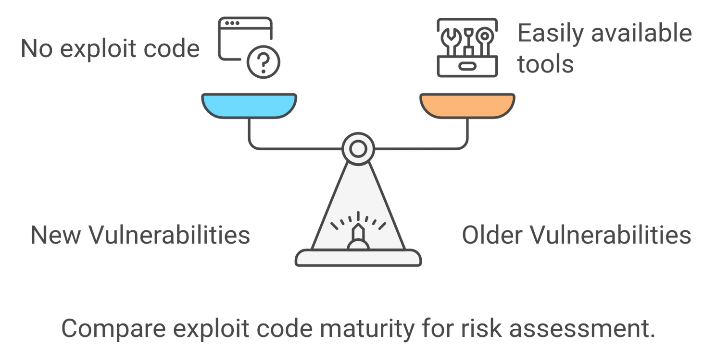
CVSS PRIMARY METRIC GROUPS
Temporal Metrics
EXPLOIT CODE MATURITY
A new bug might have no exploit code yet, but older bugs might have easily available tools to exploit them.

Slide 10
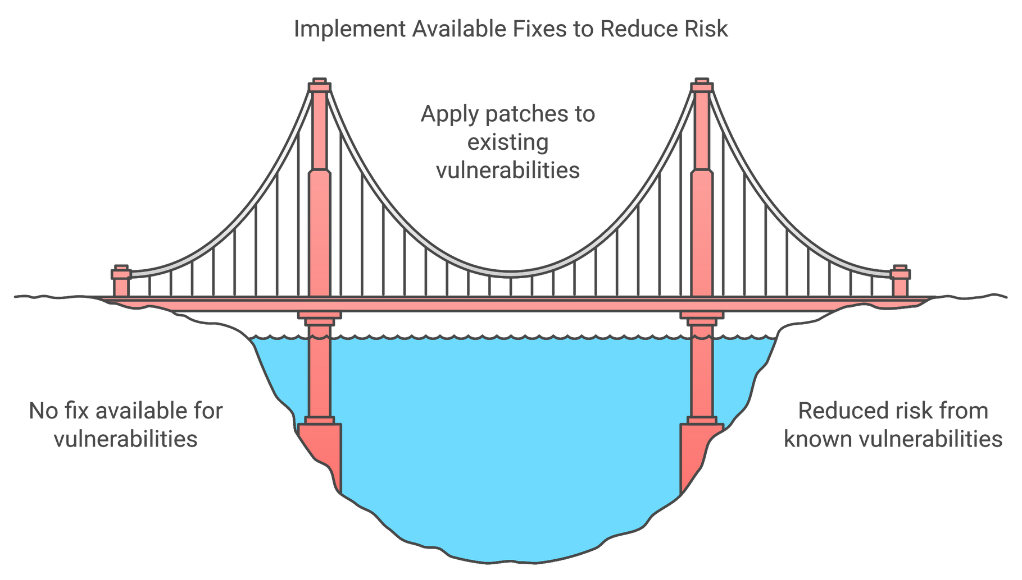
CVSS PRIMARY METRIC GROUPS
Temporal Metrics
REMEDIATION LEVEL
If a patch is ready, the risk might go down.

Slide 11
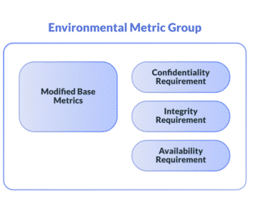
CVSS PRIMARY METRIC GROUPS
Environmental Metrics
These are specific to one’s environment, meaning the same vulnerability might be more severe for one organization than another.
Modified Base Metrics
Customizes base metrics for specific organizational contexts.
Security Requirements (CR, IR, AR)
Weigh the importance of Confidentiality, Integrity, and Availability.
Values: Low, Medium, High.

Slide 12
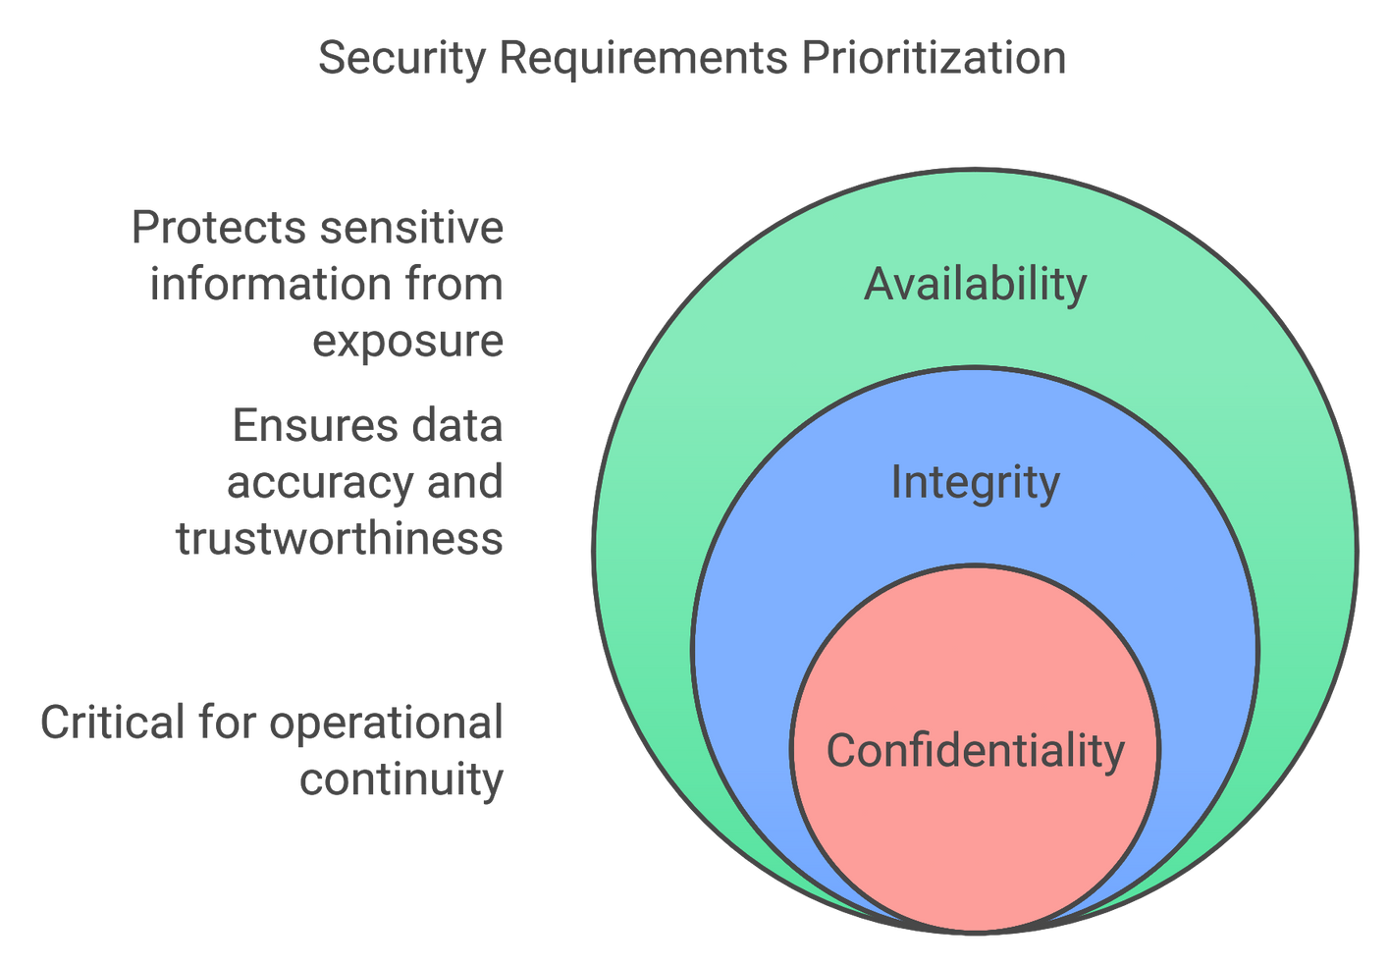
CVSS PRIMARY METRIC GROUPS
Environmental Metrics
Security Requirements
A hospital might rank Availability higher because downtime could endanger lives.

Slide 13
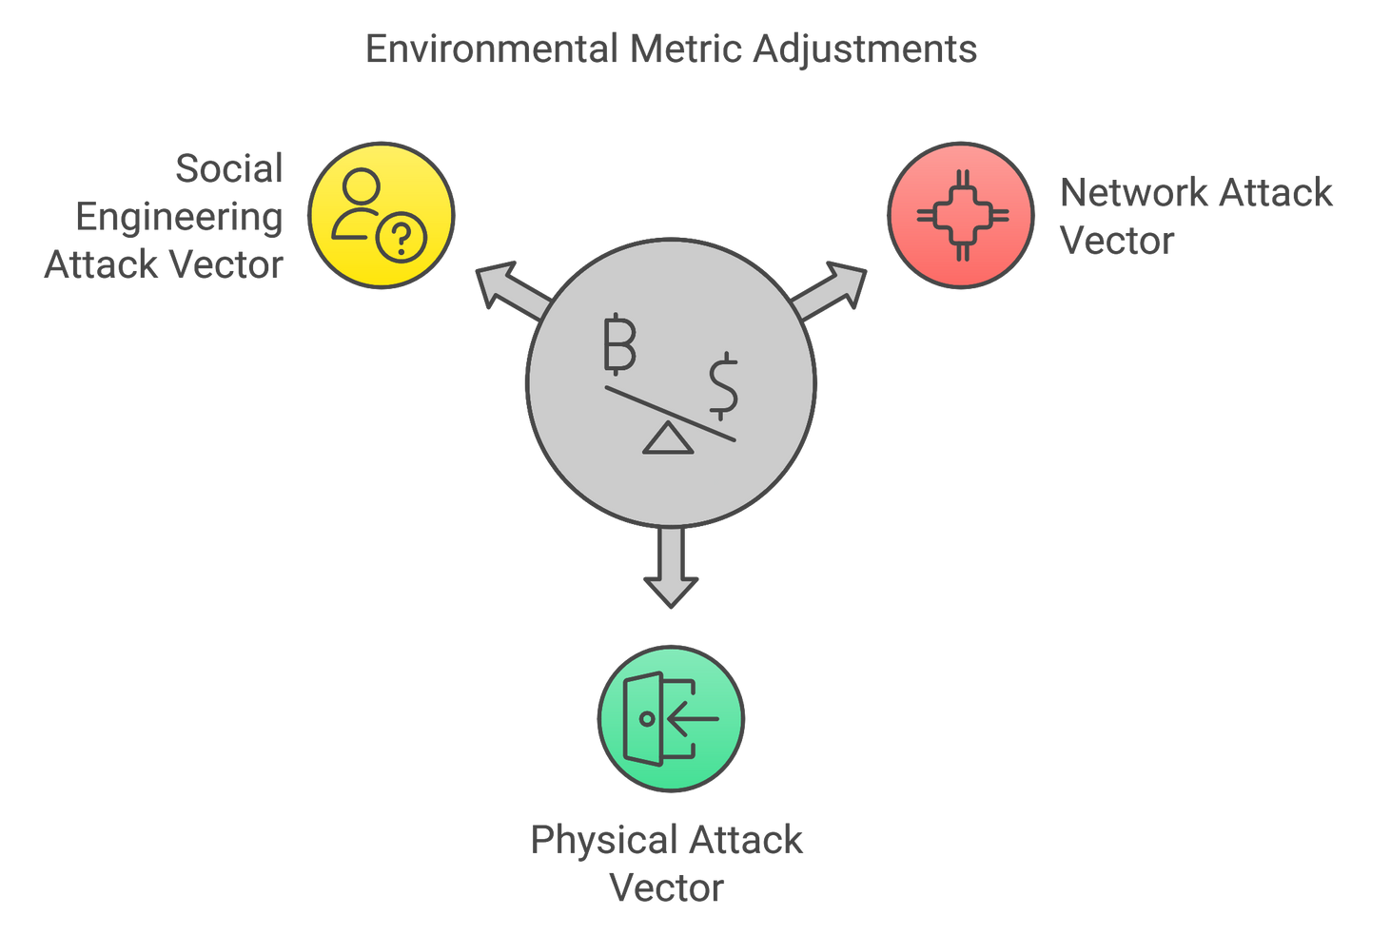
CVSS PRIMARY METRIC GROUPS
Environmental Metrics
Modified Base Metrics
If you have no external internet access, the Network attack vector might not apply.

Slide 14
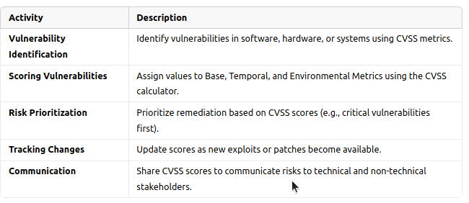
CVSS PRIMARY METRIC GROUPS
Activities in CVSS

Slide 15
CVSS PRIMARY METRIC GROUPS
Example of a CVSS
Base Metrics:
AV (Attack Vector): Network (N)
AC (Attack Complexity): Low (L)
PR (Privileges Required): None (N)
UI (User Interaction): None (N)
C (Confidentiality Impact): High (H)
I (Integrity Impact): High (H)
A (Availability Impact): High (H)
Environmental Metrics:
Confidentiality Importance: High for critical servers ⚠️
Final Score: 9.8 (Critical) 🔴
Temporal Metrics:
Exploit Available: ✅
Remediation Level: Official fix

Slide 16
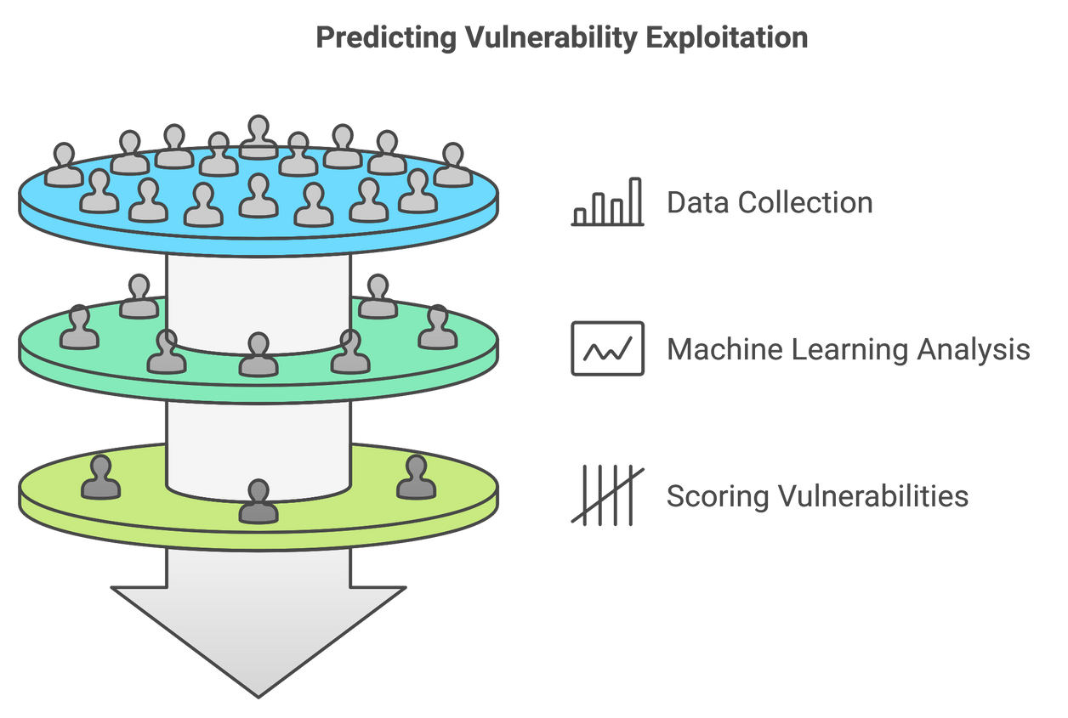
EPSS
EPSS is a scoring system that predicts the likelihood of a vulnerability being exploited in the near future. It uses historical data and machine learning models to estimate, and hence Dynamic and Data-Driven.
Complement CVSS
Developed by FIRST (Forum of Incident Response and Security Teams).

Slide 17
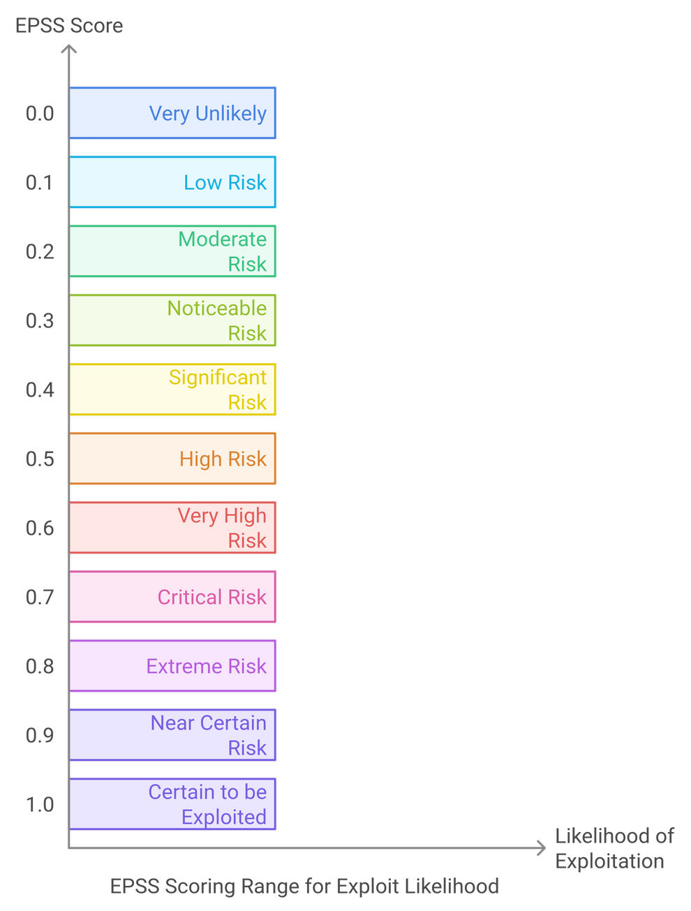
EPSS
Scoring Range
The EPSS score ranges from 0.0 (very unlikely to be exploited) to 1.0 (certain to be exploited).
Benefits
Prioritization: Focus on high-risk vulnerabilities
Efficiency: Avoid wasting resources on lower-risk vulnerabilities
Proactivity: Stay prepared for any potential attacks

Slide 18
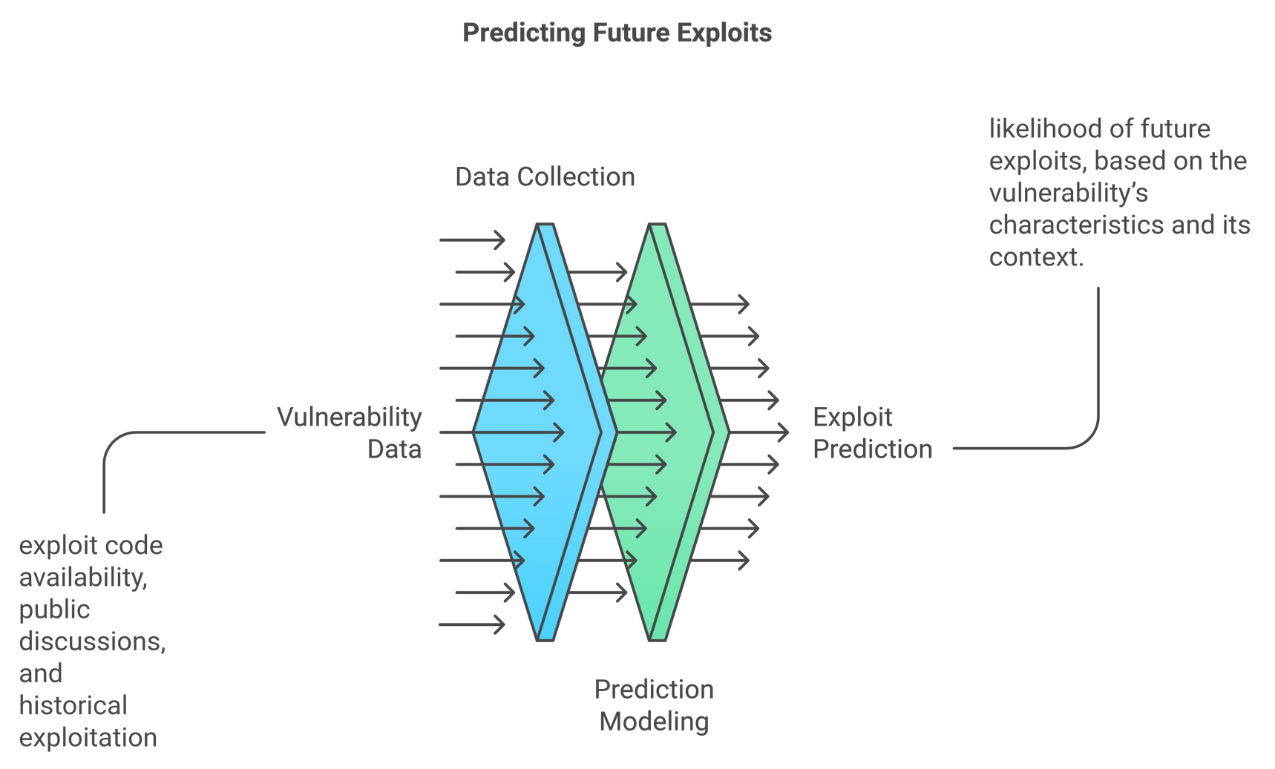
EPSS
Data Collection
ML
Scoring
How It Works
Uses information from various data sources like vulnerability database, exploit repositories, real-world attack data.
Scores probability of exploitation from 0 to 1 using ML and statistical models.
Changes assigned scores as new data becomes available.

Slide 19
EPSS
Factors Considered in EPSS
CVSS Attributes
Exploitation complexity
Historical Data
Previous vulnerability exploitation trend
Public Vulnerability Database
Information from databases like NVD (National Vulnerability Database)
Attack vector
Confidentiality, integrity, and availability impact
Current threat landscape
Likelihood of discovery of the vulnerability

Slide 20
EPSS
Why EPSS?
96% of the vulnerabilities scored with EPSS score of less than 0.1, were neither exploited or prioritized for remediation (True Negative (TN)). 1.8% were both exploited and prioritized for remediation (TP).
Source: https://orca.security/resources/blog/epss-scoring-system-explained/
Vulnerabilities are constantly discovered.
Not all vulnerabilities are exploited.
Focuses efforts on the highest risk.

Slide 21
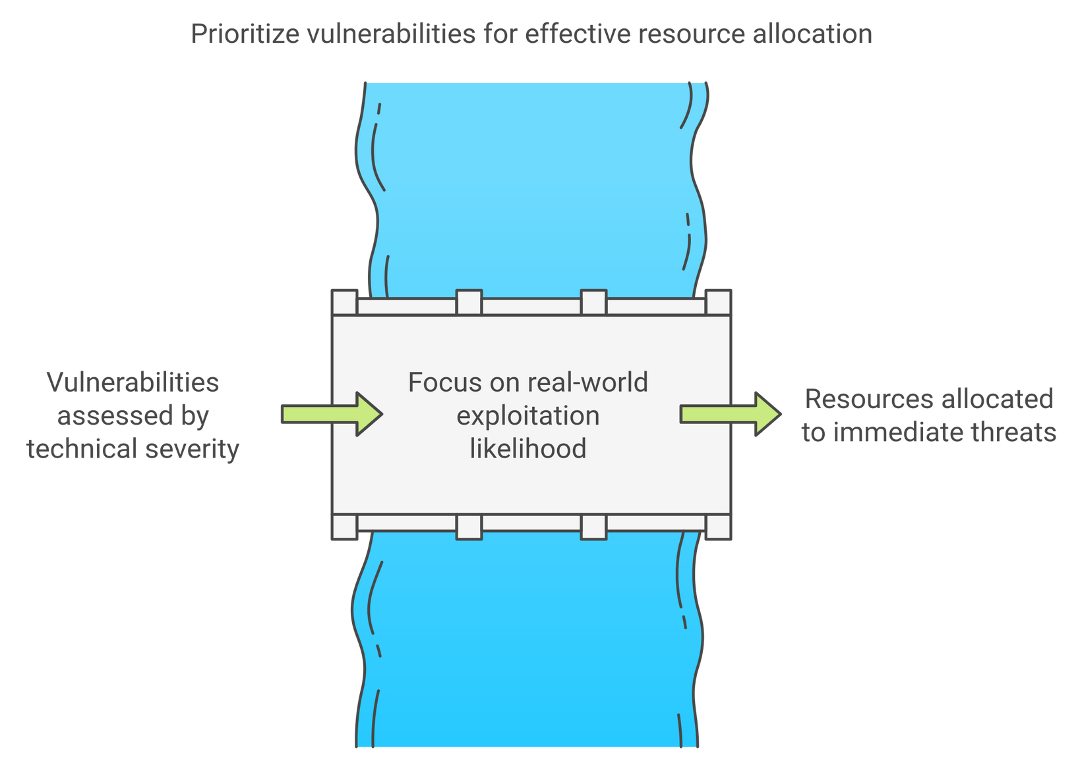
EPSS
Challenges Addressed
Overwhelming Number of Vulnerabilities
Ineffective Prioritization
Resource Constraints

Slide 22
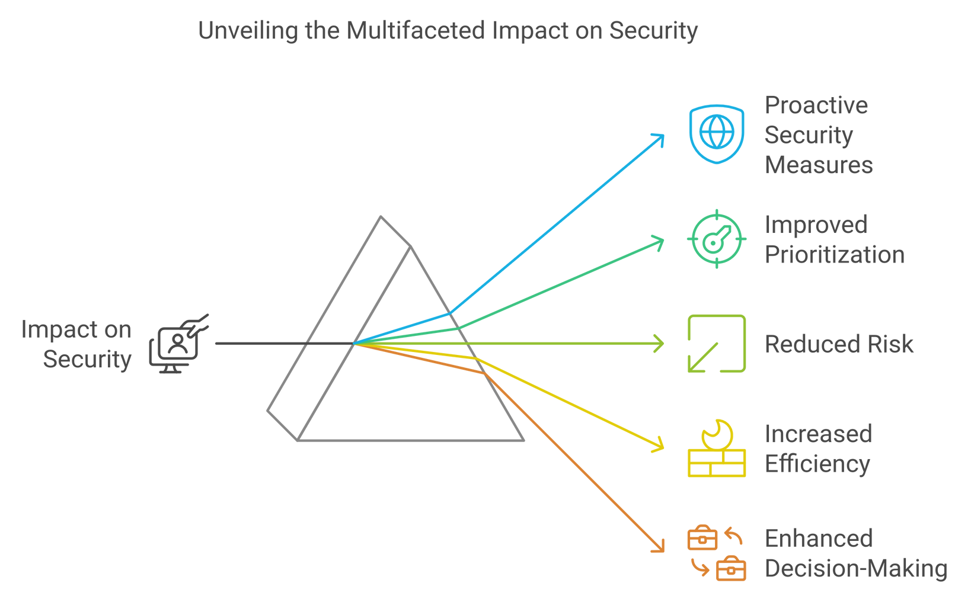
EPSS
Impacts

Slide 23
EPSS
How to Use EPSS?
Access EPSS scores through the FIRST website. https://www.first.org/epss/
Integrate EPSS into vulnerability management workflow.
Use EPSS to complement CVSS and other security tools.
EPSS in Action
1. A vulnerability with CVSS 9 but EPSS 0.05
Action: lower priority
2. A vulnerability with CVSS 7 but EPSS 0.9
Action: higher priority

Slide 24
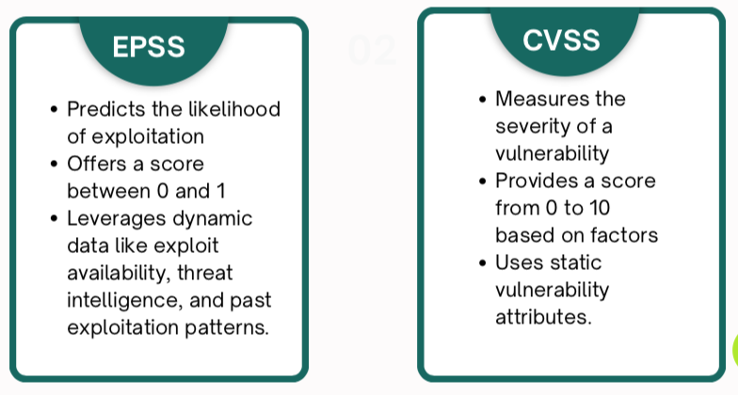
EPSS vs CVSS

Slide 25

THANK YOU!

